Slide 1
Artificial Intelligence, Data analytics, Data Science

Slide 2
Data Science

Slide 3
What is data science
Data Science is a blend of various tools, algorithms, and machine learning principles with the goal to discover hidden patterns from the raw data.
It not only explains the data but also predicts from the same.
Data Analyst usually explains what is going on by processing history of the data
Mathematics
Statistical Research
Machine Learning
Domain
Expert
Computer
Science
Data Science
Data Processing

Slide 4
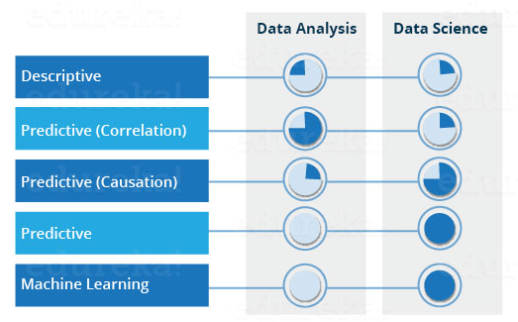
Data analysis vs Data Science

Slide 5
Why Data Science?
Traditionally the data was structured and analysis was comparatively easy.
Now, more than 80% of the data is unstructured and traditional methods cannot work on such data
Also, very specific requirements from the customer about existing data raises the demand for data science.

Slide 6
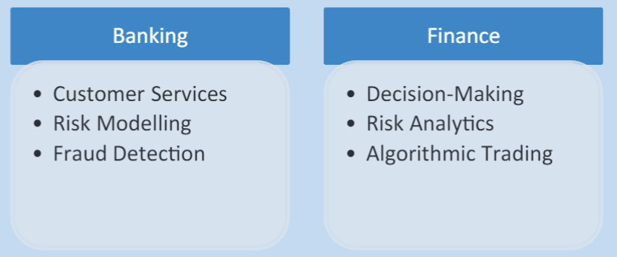
Applications of Data Science

Slide 7
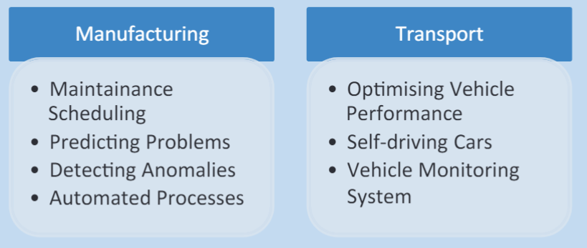
Applications of Data Science

Slide 8
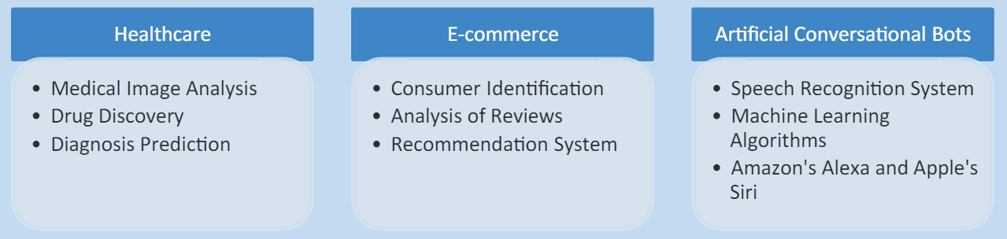
Applications of Data Science

Slide 9
An Example with Data Science

Slide 10
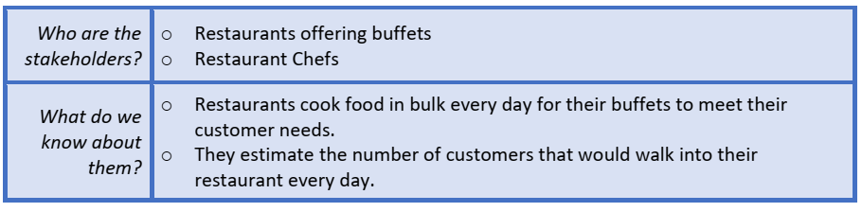
Problem Scoping
Who?

Slide 11
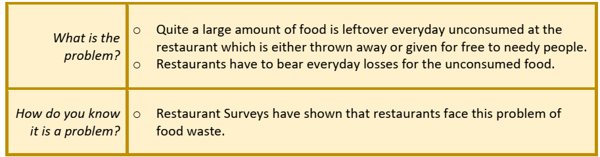
What?

Slide 12
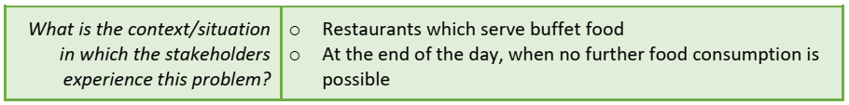
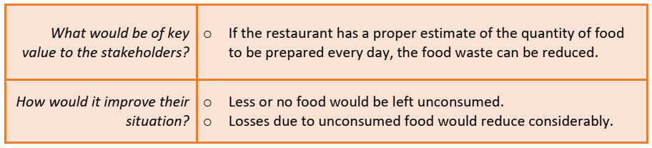
Where?
Why?

Slide 13
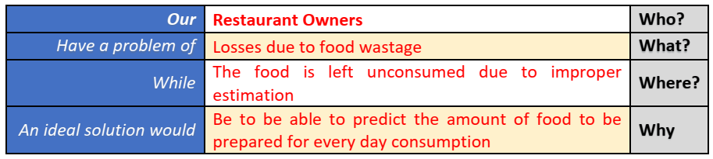
Problem Statement

Slide 14
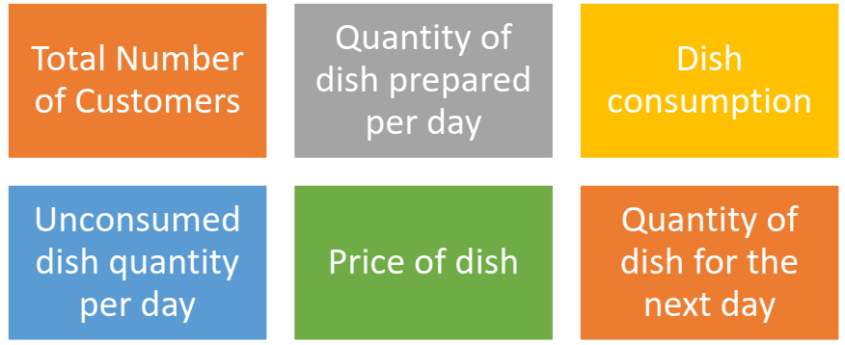
Data Acquisition

Slide 15
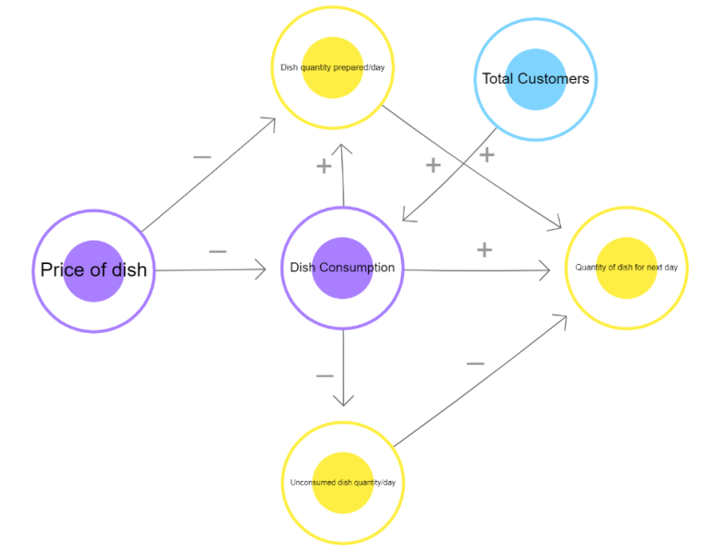
Data mapping
Connect them to make a decision tree
Elements:
Dish Quantity
Dish Price
Total Customers
Dish consumption
Quantity for next day
Unconsumed dish quantity

Slide 16
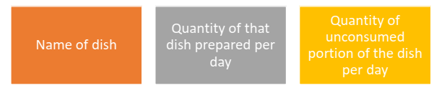
Data Exploration
After creating the database, we now need to look at the data collected and understand what is required out of it.
In this case, since the goal of our project is to be able to predict the quantity of food to be prepared for the next day, we need to have the following data:

Slide 17
Modeling
A regression model is chosen in which the dataset is fed as a dataframe and is trained accordingly.
Since in our case the data which we have is a continuous data of 30 days, we can use the regression model so that it predicts the next values to it in a similar manner.
In this case, the dataset of 30 days is divided in a ratio of 2:1 for training and testing respectively.
In this case, the model is first trained on the 20-day data and then gets evaluated for the rest of the 10 days.

Slide 18
Evaluation
Once the model has been trained on the training dataset of 20 days, it is now time to see if the model is working properly or not
Step 1: The trained model is fed data regards the name of the dish and the quantity produced for the same. Step 2: It is then fed data regards the quantity of food left unconsumed for the same dish on previous occasions.
Step 3: The model then works upon the entries according to the training it got at the modelling stage.
Step 4: The Model predicts the quantity of food to be prepared for the next day.

Slide 19
Step 5: The prediction is compared to the testing dataset value. From the testing dataset, ideally, we can say that the quantity of food to be produced for next day’s consumption should be the total quantity minus the unconsumed quantity. Step 6: The model is tested for 10 testing datasets kept aside while training. Step 7: Prediction values of testing dataset is compared to the actual values. Step 8: If the prediction value is same or almost similar to the actual values, the model is said to be accurate. Otherwise, either the model selection is changed or the model is trained on more data for better accuracy.

Slide 20
Data Collection

Slide 21
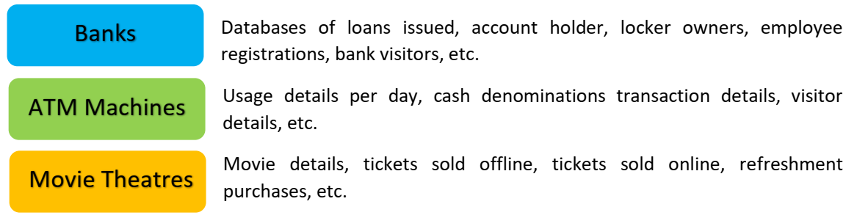

Commonly used datasets

Slide 22
Open-Source Datasets
Lionbridge AI
Amazon Mechanical Turk
LabelBox
Figure Eight
Kaggle
http://mospi.nic.in/data

Slide 23
Big Data
Big Data is a collection of data that is huge in volume, yet growing exponentially with time.
It is a data with so large size and complexity that none of traditional data management tools can store it or process it efficiently.

Slide 24
Examples of Big Data
The New York Stock Exchange generates about one terabyte of new trade data per day.
The statistic shows that 500+terabytes of new data get ingested into the databases of social media site Facebook, every day.
A single Jet engine can generate 10+terabytes of data in 30 minutes of flight time.

Slide 25
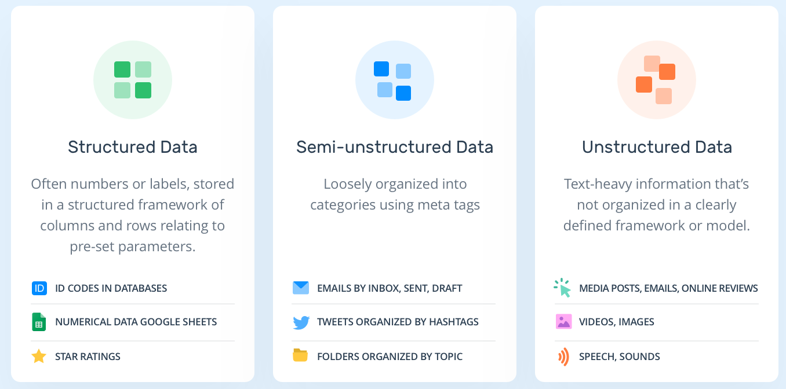
Types of Big Data

Slide 26
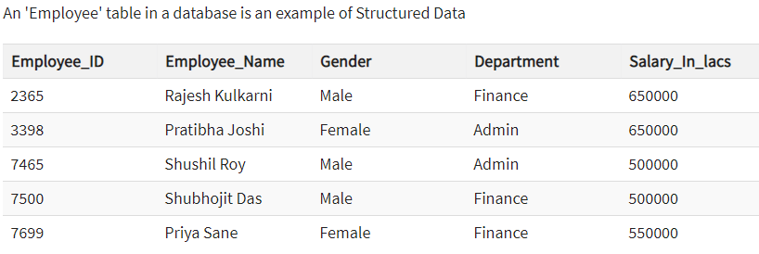
Structured

Slide 27
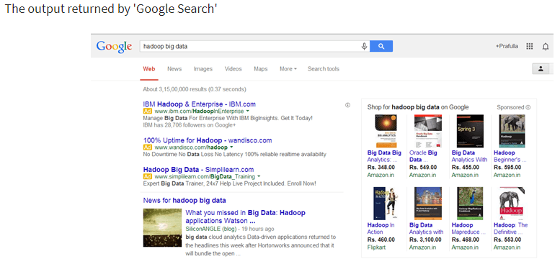
Unstructured

Slide 28
Training Testing and Validation
Training set: The data where the model is trained on
Validation set: Data the model has not been trained on and used to tune hyperparameters
Test set: In principle the same like the validation set.. just used at the final end after the model has been tailored.

Slide 29
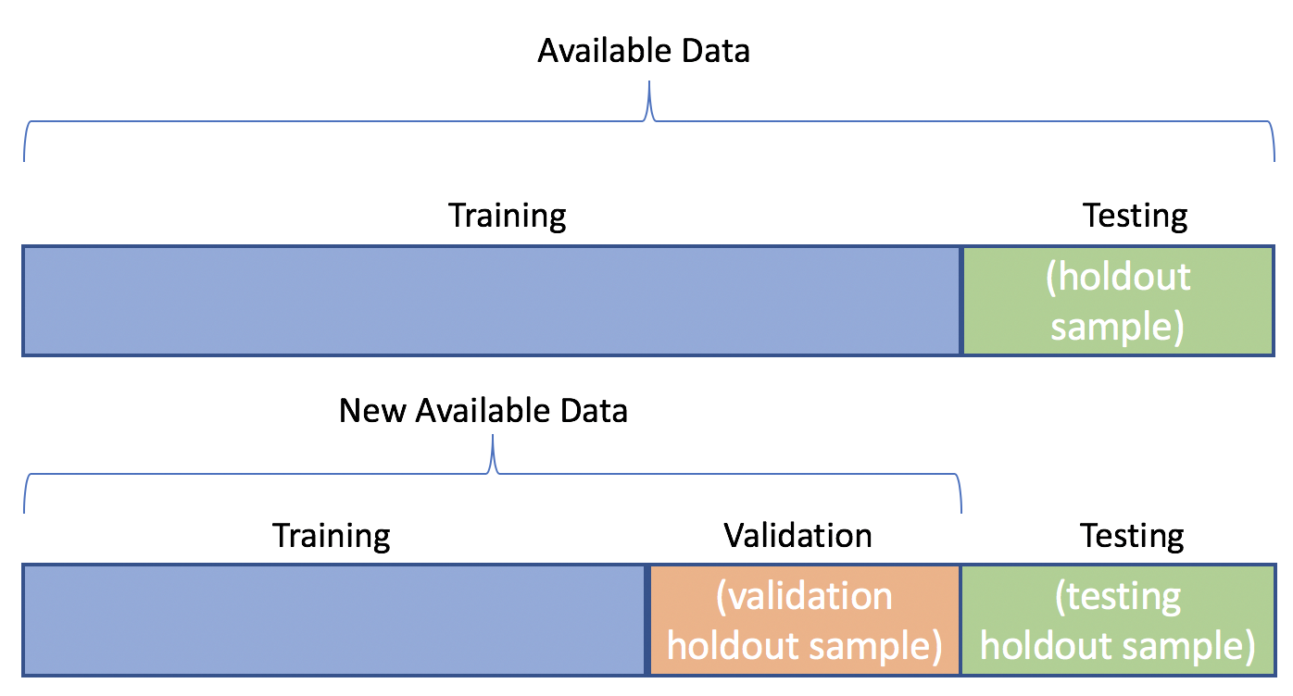

Slide 30
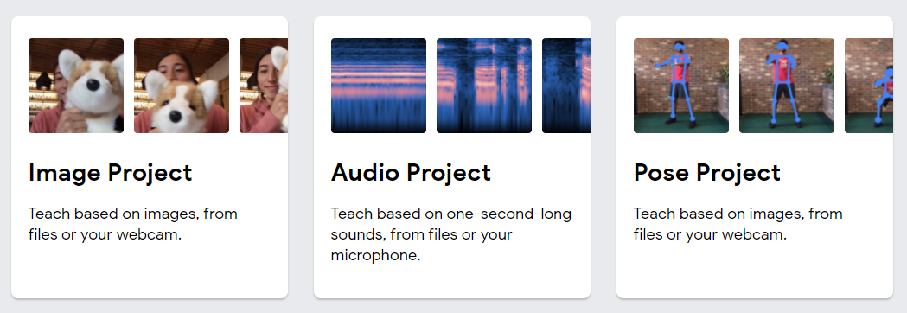
Data acquisition demo
https://teachablemachine.withgoogle.com/
Click on Get started

Slide 31
Data Exploration

Slide 32
Data visualization tools
Microsoft Excel
Tableau
Qlikview
Datawrapper
Google Data Studio

Slide 33
Why do we need to visualize
Quickly get a sense of the trends, relationships and patterns contained within the data.
Define strategy for which model to use at a later stage.
Communicate the same to others effectively.
To visualise data, we can use various types of visual representations.

Slide 34
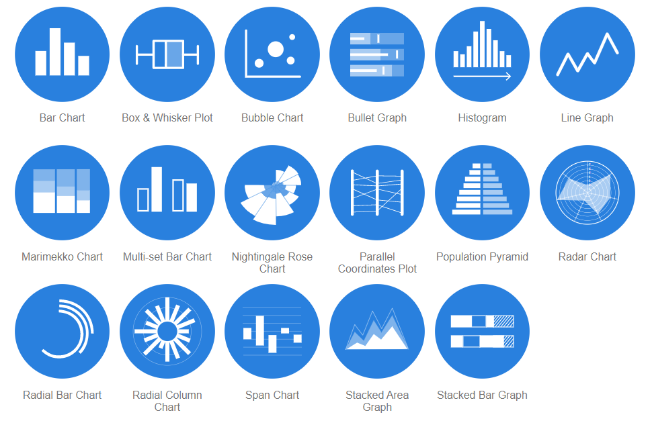
Data Visualization methods
https://datavizcatalogue.com/

Slide 35
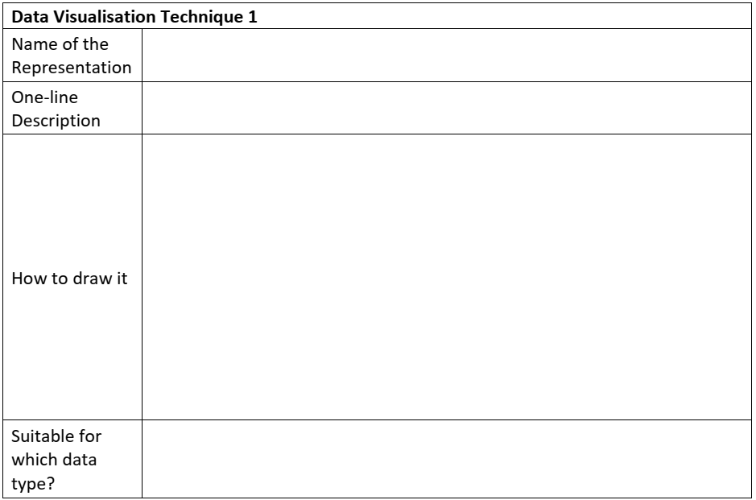
Student worksheet

Slide 36
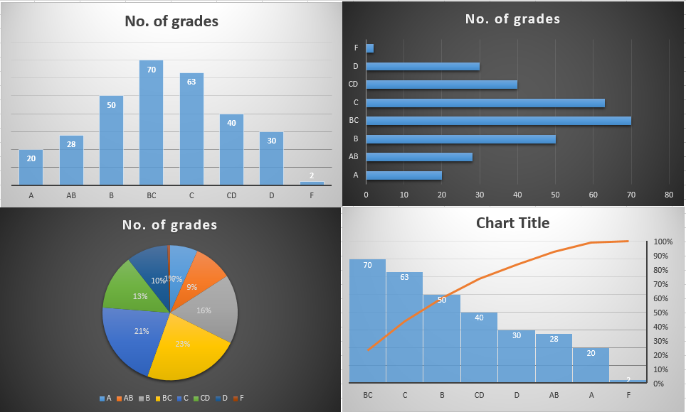
Example in Excel
Grade | No. of grades
A | 20
AB | 28
B | 50
BC | 70
C | 63
CD | 40
D | 30
F | 2

Slide 37
Multidimensional data
http://projector.tensorflow.org/
Visualize a 200 dimensional data

Slide 38
Modeling

Slide 39
Modeling
AI models – Rule based and learning based
Learning based - ML and DL
Complete the teachable game
AI models – Rule based and learning based
Learning based – Supervised, Unsupervised, Reinforcement
Regression, Classification, Clustering, Dimensionality reduction
Evaluation

Slide 40
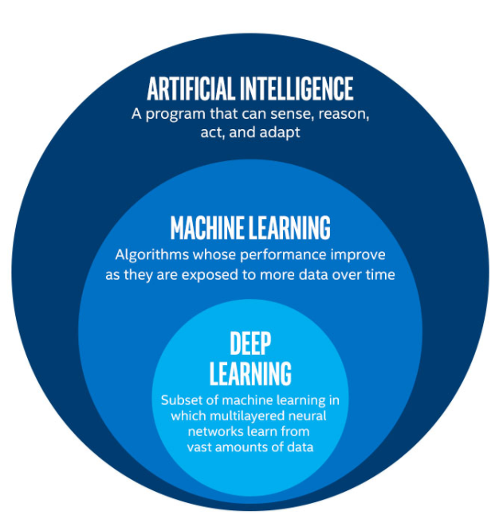
AI ML and DL

Slide 41
AI, ML and DL
Artificial Intelligence, or AI, refers to any technique that enables computers to mimic human intelligence.
Machine Learning, or ML, enables machines to improve at tasks with experience. The machine learns from its mistakes and takes them into consideration in the next execution.
Deep Learning, or DL, enables software to train itself to perform tasks with vast amounts of data. In deep learning, the machine is trained with huge amounts of data which helps it into training itself around the data.

Slide 42
Modeling
AI Modelling refers to developing algorithms, also called models which can be trained to get intelligent outputs.
That is, writing codes to make a machine artificially intelligent.

Slide 43
Types of AI models
AI Models
Rule based
Learning based
Machine Learning
Deep Learning

Slide 44
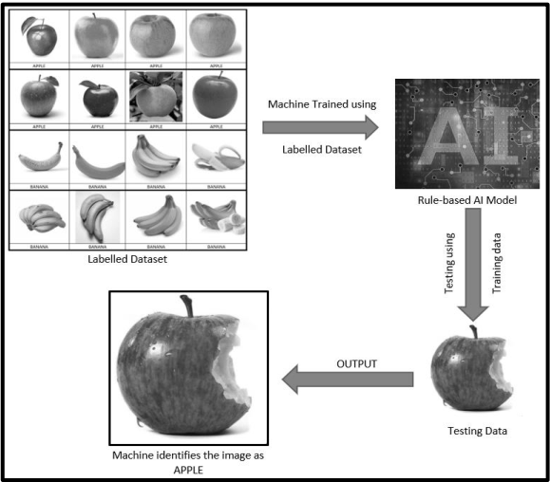
Rule based model

Slide 45
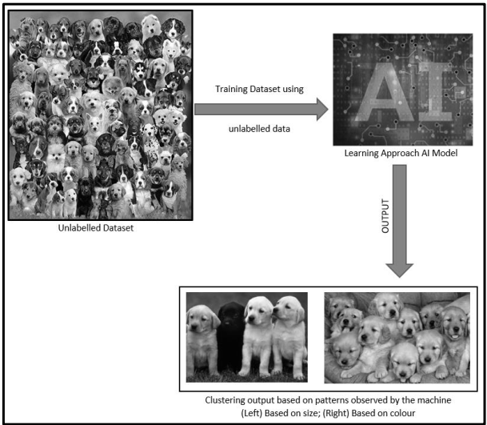
Learning based model
For example, suppose you have a dataset of 1000 images of random stray dogs of your area.
Thus, you would put this into a learning approach based AI machine.
It might cluster the data on the basis of colour, size, fur style, etc.

Slide 46
Decision tree
Decision tree builds classification or regression models in the form of a tree structure.
It breaks down a dataset into smaller and smaller subsets while at the same time an associated decision tree is incrementally developed.
The final result is a tree with decision nodes and leaf nodes.

Slide 47
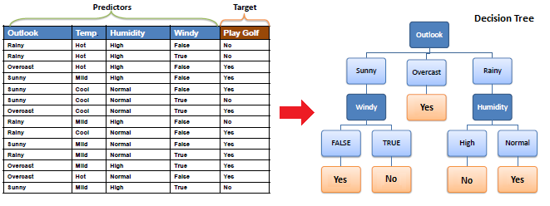
Example

Slide 48
Types of learnings
Learning based
Supervised Learning
Unsupervised Learning
Reinforcement Learning

Slide 49
Supervised Learning
In a supervised learning model, the dataset which is fed to the machine is labelled.
A label is some information which can be used as a tag for data.
For example, students get grades according to the marks they secure in examinations.
These grades are labels which categorise the students according to their marks.
Classification
Regression

Slide 50
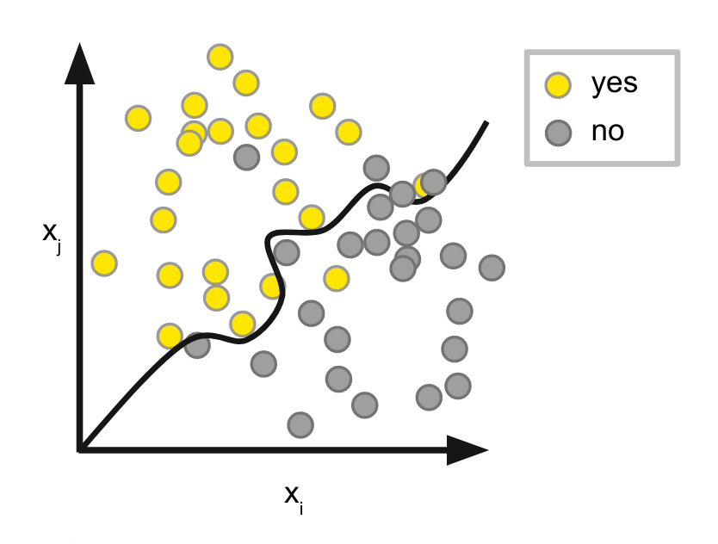
Classification
Where the data is classified according to the labels.
The entries are divided in two classes normally.
The boundary condition is defined to classify.

Slide 51
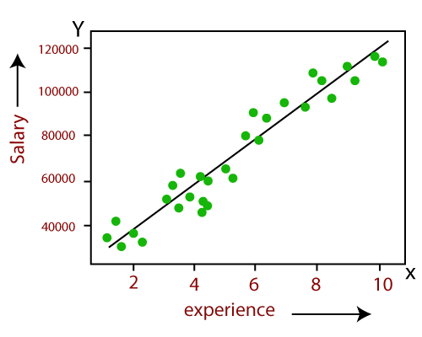
Regression
Regression deals with continuous data.
For example, if we know the growth rate, we can predict the salary of someone after a certain number of years.
Regression is linear as well as non-linear.

Slide 52
Unsupervised Learning
An unsupervised learning model works on unlabelled dataset.
This means that the data which is fed to the machine is random and there is a possibility that the person who is training the model does not have any information regarding it.
The unsupervised learning models are used to identify relationships, patterns and trends out of the data which is fed into it.
It helps the user in understanding what the data is about and what are the major features identified by the machine in it.

